Slide 1
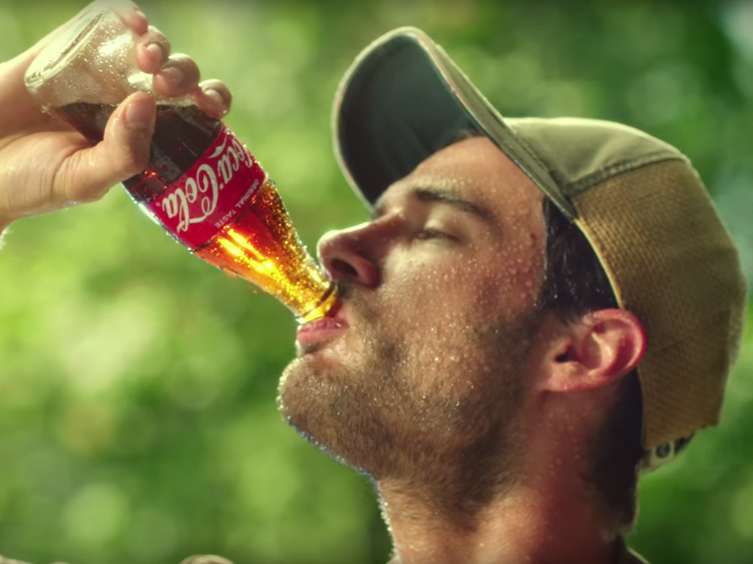
Coca Cola
Mayor Of Africa

Slide 2
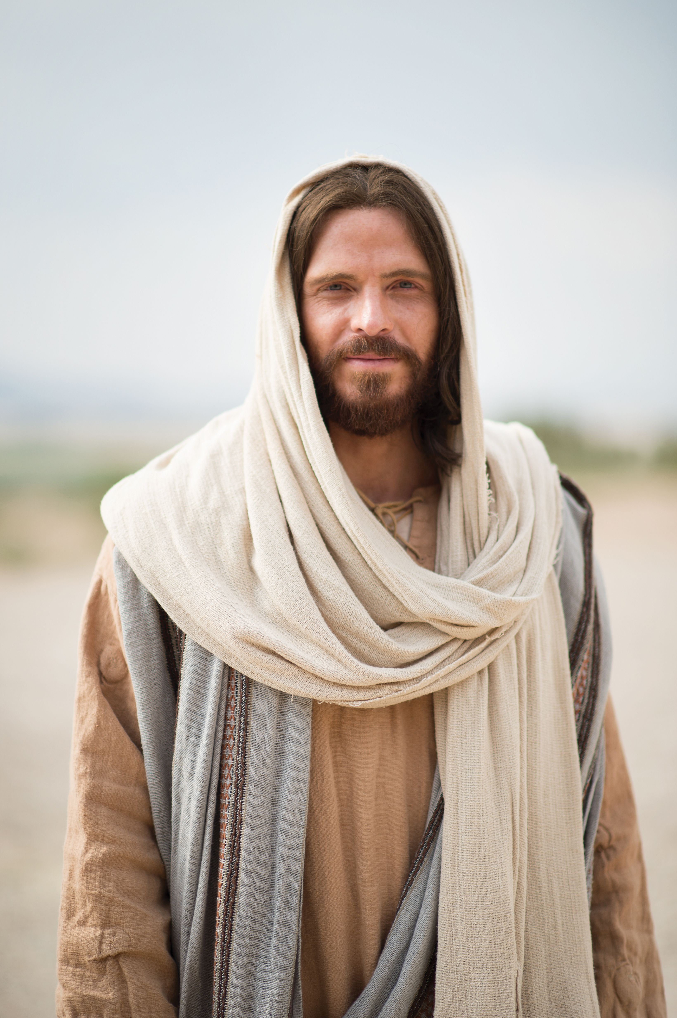
Jesus Christ
The Savior of the world
Emmy_Cee

